Slide 1
GAN and game

Slide 2
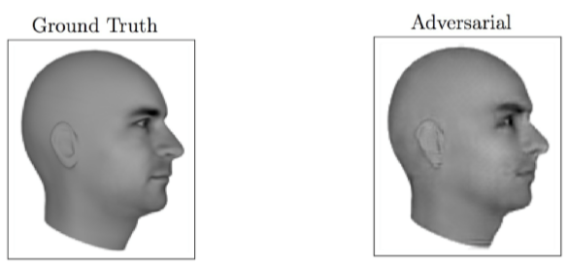
Magic of GANs

Slide 3
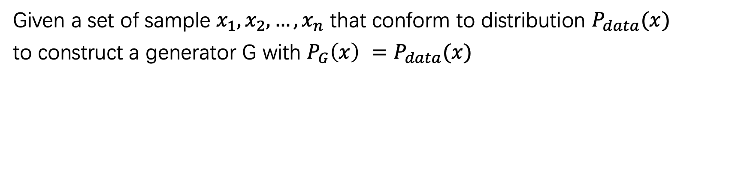
Objective
Given a set of sample $x_{1},x_{2}, …,x_{n}$ that conform to distribution $P_{data}(x)$
to construct a generator G with ${P_{G}\left(x\right) =P}_{data}(x)$

Slide 4
Generative models
Boltzmann machine and RBM
MCMC
AE
VAE
GAN

Slide 5
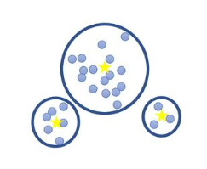
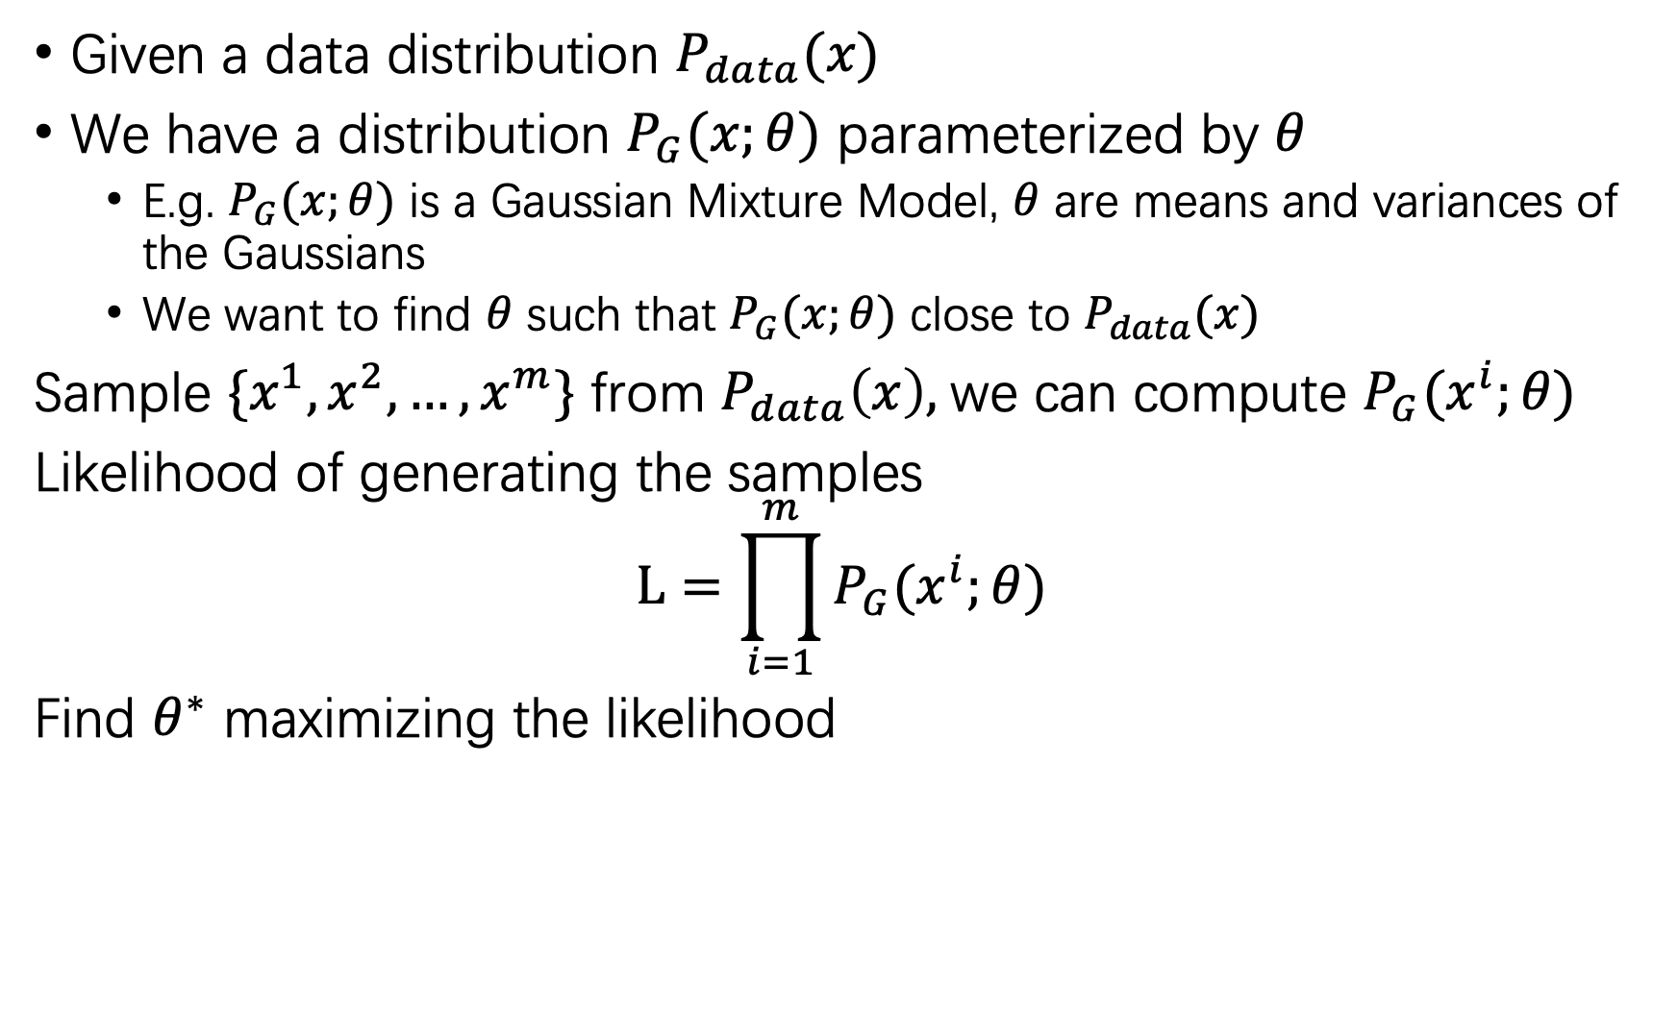
Maximum Likelihood Estimation
Given a data distribution $P_{data}(x)$
We have a distribution $P_{G}(x;θ)$ parameterized by $θ$
E.g. $P_{G}(x;θ)$ is a Gaussian Mixture Model, $θ$ are means and variances of the Gaussians
We want to find $θ$ such that $P_{G}(x;θ)$ close to $P_{data}(x)$
Sample $\{x^{1}, x^{2}, …, x^{m}\}$ from $P_{data}\left(x\right),$we can compute $P_{G}(x^{i};θ)$
Likelihood of generating the samples
$$L=\prod_{i=1}^{m}{P_{G}(x^{i};θ) }$$
Find $θ^{∗}$ maximizing the likelihood

Slide 6
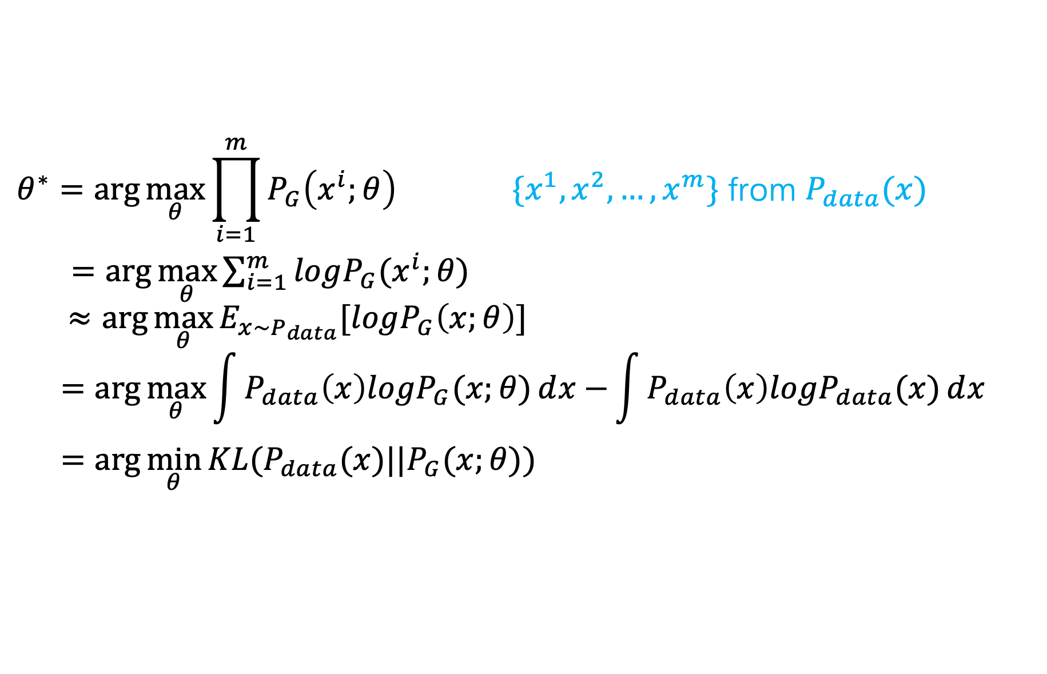
Maximum Likelihood Estimation
$$θ^{∗}=\arg{\max_{θ}{\prod_{i=1}^{m}{P_{G}\left(x^{i};θ\right)}}} \{x^{1}, x^{2}, …, x^{m}\} \text{from} P_{data}(x)$$
$=\arg{\max_{θ}{\sum_{i=1}^{m}{logP_{G}(x^{i};θ)}}}$
$$≈\arg{\max_{θ}{E_{x\sim P_{data}}[logP_{G}\left(x;θ\right)]}}$$
$$=\arg{\max_{θ}{\int{P_{data}\left(x\right)logP_{G}(x;θ)ⅆx}−}}\int{P_{data}\left(x\right)logP_{data}(x)ⅆx}$$
$$=\arg{\min_{θ}{KL(P_{data}(x)||P_{G}(x;θ))}}$$

Slide 7
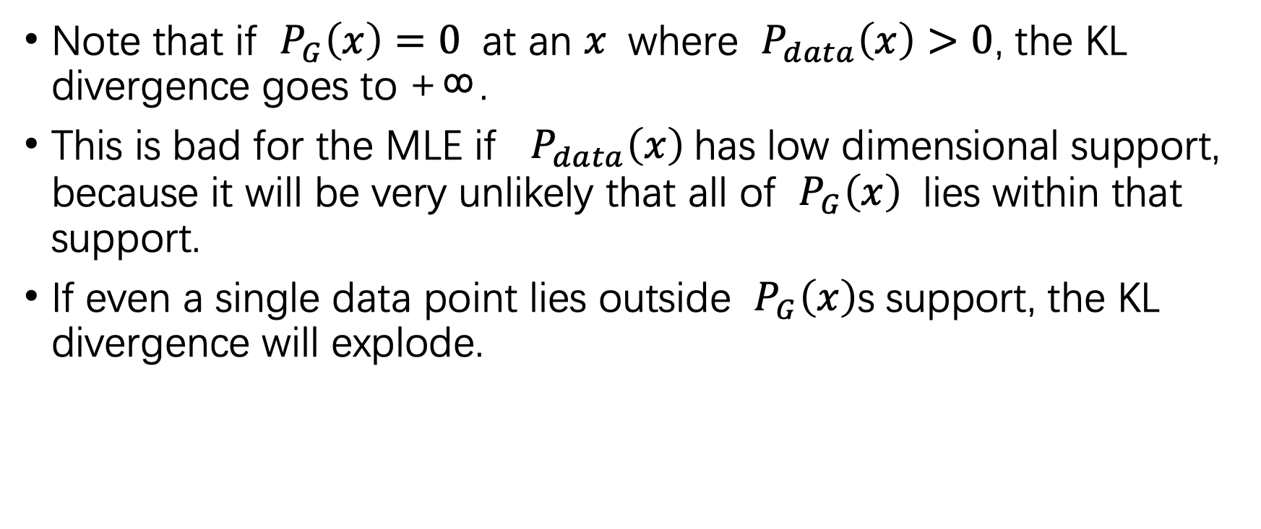
Difficulties in MLE: from the viewpoint of KL
Note that if $P_{G}\left(x\right)=0$ at an $x$ where $P_{data}\left(x\right)>0$, the KL divergence goes to +∞.
This is bad for the MLE if $P_{data}\left(x\right)$has low dimensional support, because it will be very unlikely that all of $P_{G}\left(x\right)$ lies within that support.
If even a single data point lies outside $P_{G}\left(x\right)$s support, the KL divergence will explode.

Slide 8
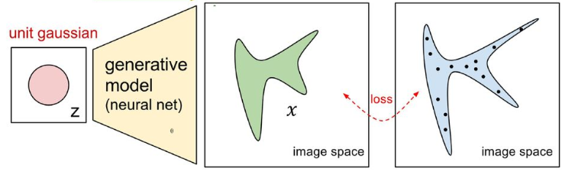
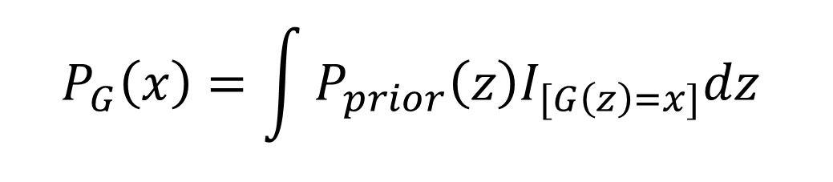



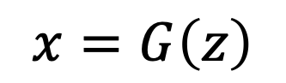
Now $P_{G}(x;θ)$ is a NN
$$P_{G}(x;θ)$$
Generated distribution
$$P_{data}(x)$$
True data distribution
$$x=G\left(z\right)$$
$$P_{G}\left(x\right)=\int{P_{prior}\left(z\right)I_{[G\left(z\right)=x]}dz}$$
It is difficult to compute the likelihood.

Slide 9
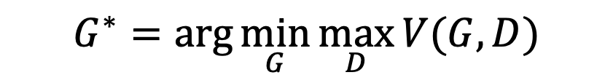
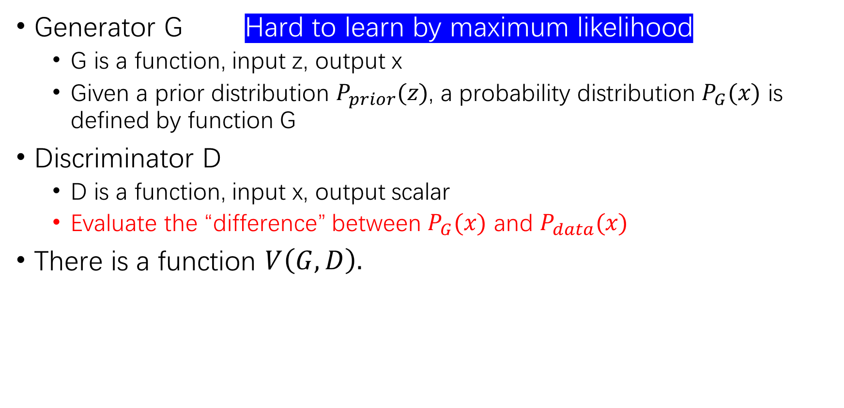
Basic Idea of GAN
Generator G Hard to learn by maximum likelihood
G is a function, input z, output x
Given a prior distribution $P_{prior}(z)$, a probability distribution $P_{G}(x)$ is defined by function G
Discriminator D
D is a function, input x, output scalar
Evaluate the “difference” between $P_{G}(x)$ and $P_{data}(x)$
There is a function $V\left(G, D\right).$
$$V(G,D)=E_{x\sim P_{data}}\left[logD\left(x\right)\right]+E_{x\sim P_{G}}[\log\left(1−D\left(x\right)\right)]$$
$$G^{∗}=\arg{\min_{G}{\max_{D}{V(G, D)}}}$$

Slide 10
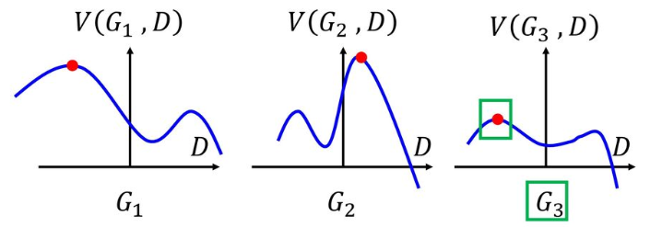
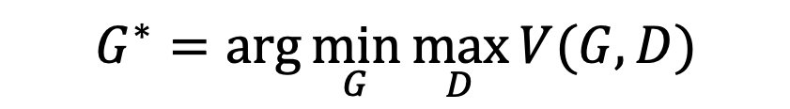
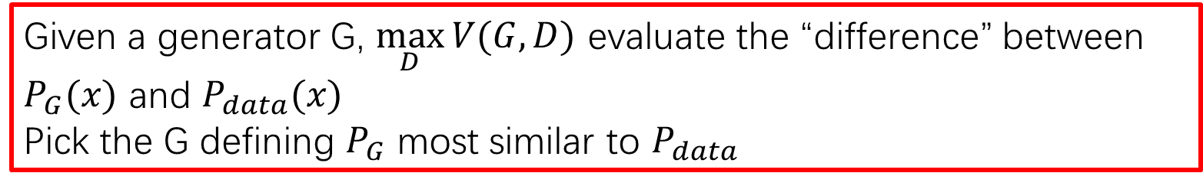
Basic Idea
$$G^{∗}=\arg{\min_{G}{\max_{D}{V(G, D)}}}$$
$$V(G,D)=E_{x\sim P_{data}}\left[logD\left(x\right)\right]+E_{x\sim P_{G}}[\log\left(1−D\left(x\right)\right)]$$
Given a generator G, $\max_{D}{V(G, D)}$ evaluate the “difference” between $P_{G}(x)$ and $P_{data}(x)$
Pick the G defining $P_{G}$ most similar to $P_{data}$

Slide 11
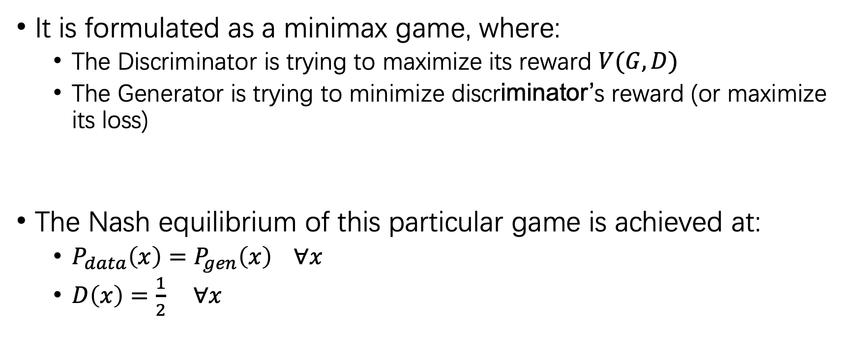

Basic idea
$$G^{∗}=\arg{\min_{G}{\max_{D}{V(G, D)}}}$$
It is formulated as a minimax game, where:
The Discriminator is trying to maximize its reward $V(G, D)$
The Generator is trying to minimize discriminator’s reward (or maximize its loss)
The Nash equilibrium of this particular game is achieved at:
$P_{data}\left(x\right)=P_{gen}\left(x\right) ∀x$
$D\left(x\right)=\frac{1}{2}$ $∀x$
$$V=E_{x\sim P_{data}}\left[logD\left(x\right)\right]+E_{x\sim P_{G}}[\log\left(1−D\left(x\right)\right)]$$

Slide 12
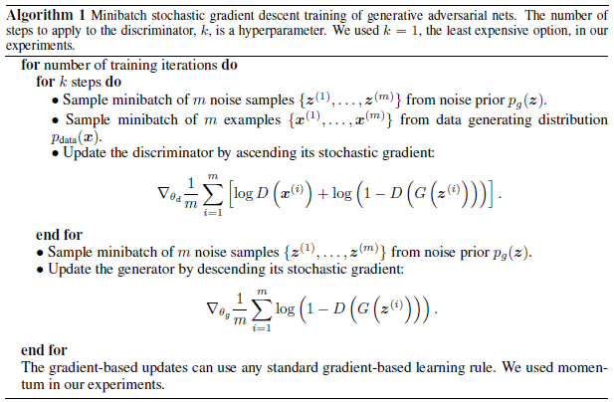
Discriminator updates
Generator updates

Slide 13
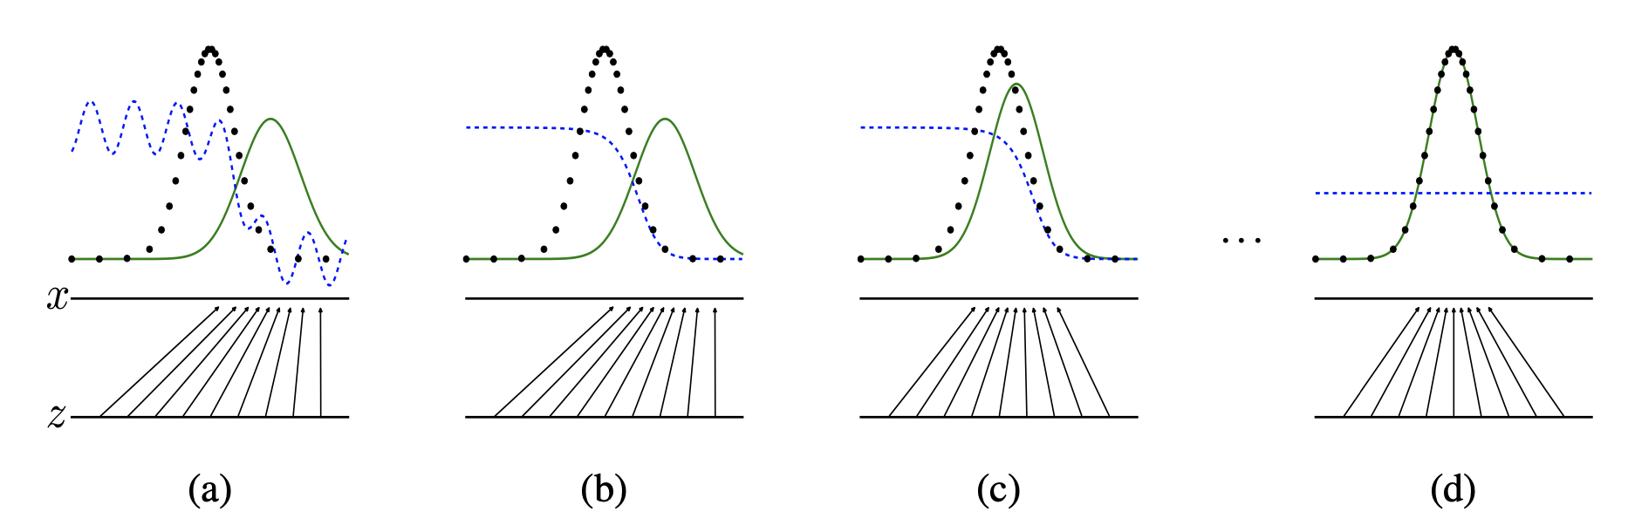
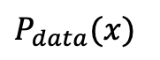
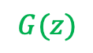
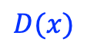
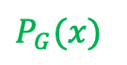
Diagram
$P_{data}(x)$
$P_{G}(x)$
$D(x)$
$$G(z)$$

Slide 14
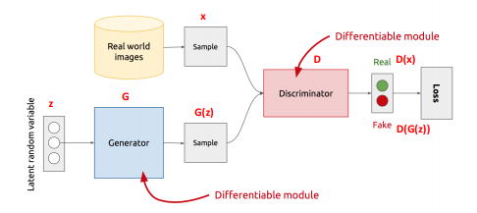
GAN’s Architecture
z is some random noise (Gaussian/Uniform)
z can be thought as the latent representation of the image.

Slide 15
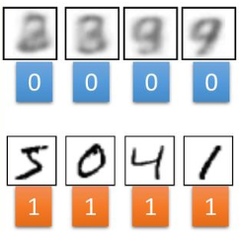
GAN – Training Discriminator
Randomly
Sample a vector
NN Generator v1
Something like Decoder in VAE
Real images:
Discriminator
v1
image
1/0 (real or fake)
According to label

Slide 16
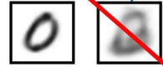
GAN – Training Generator
Randomly
Sample a vector
Updating
the parameters of generator
NN Generator v1
v2
The output of generator should be classified as “real” as possible
Generator + Discriminator
= a net work
Discriminator v1
Using gradient descent to update the parameters in the generator, but fix the discriminator
0.13
1.0

Slide 17
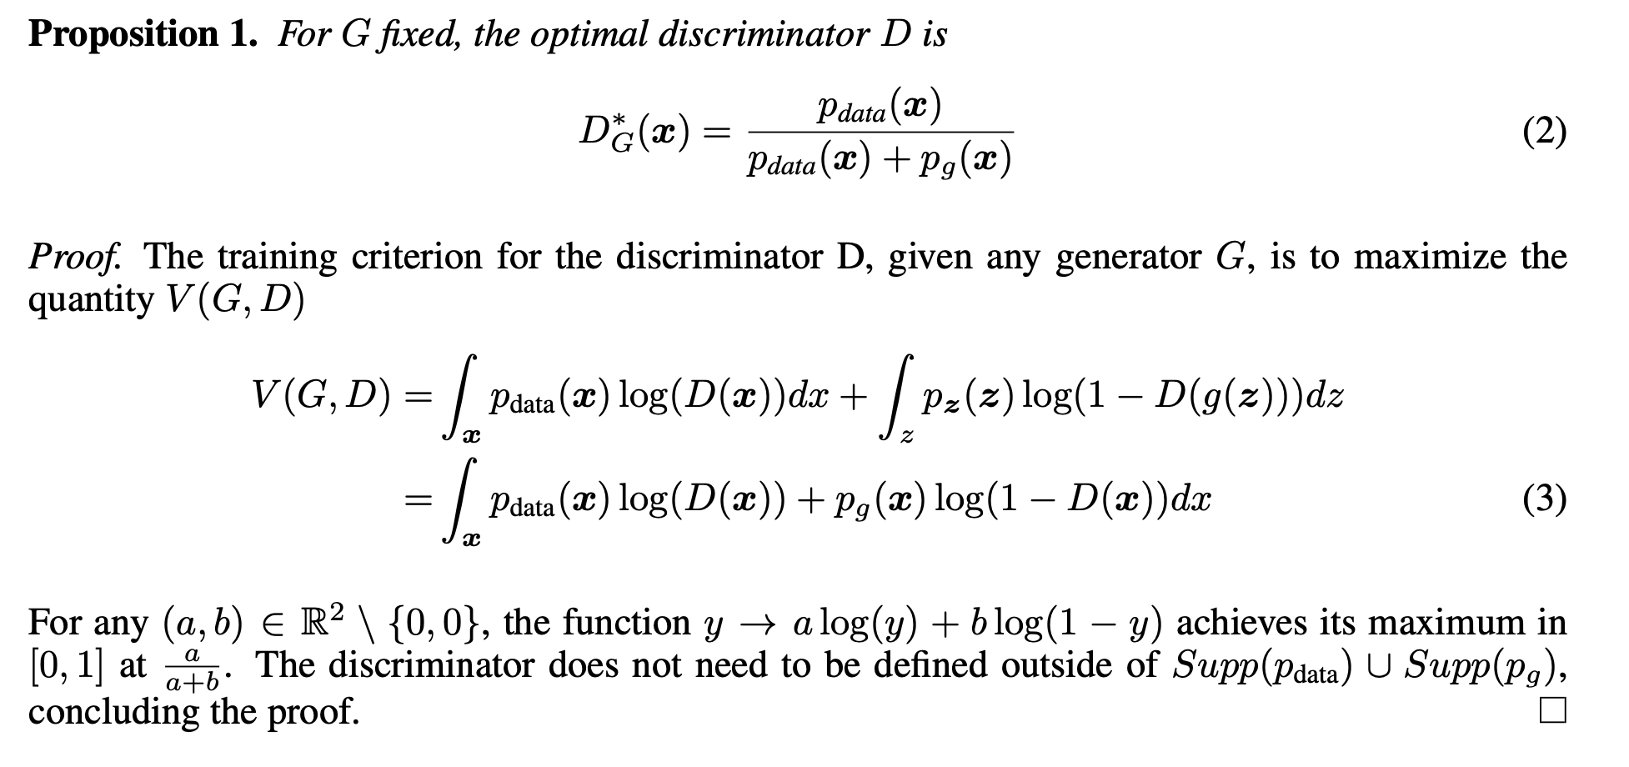
Theoretical results

Slide 18
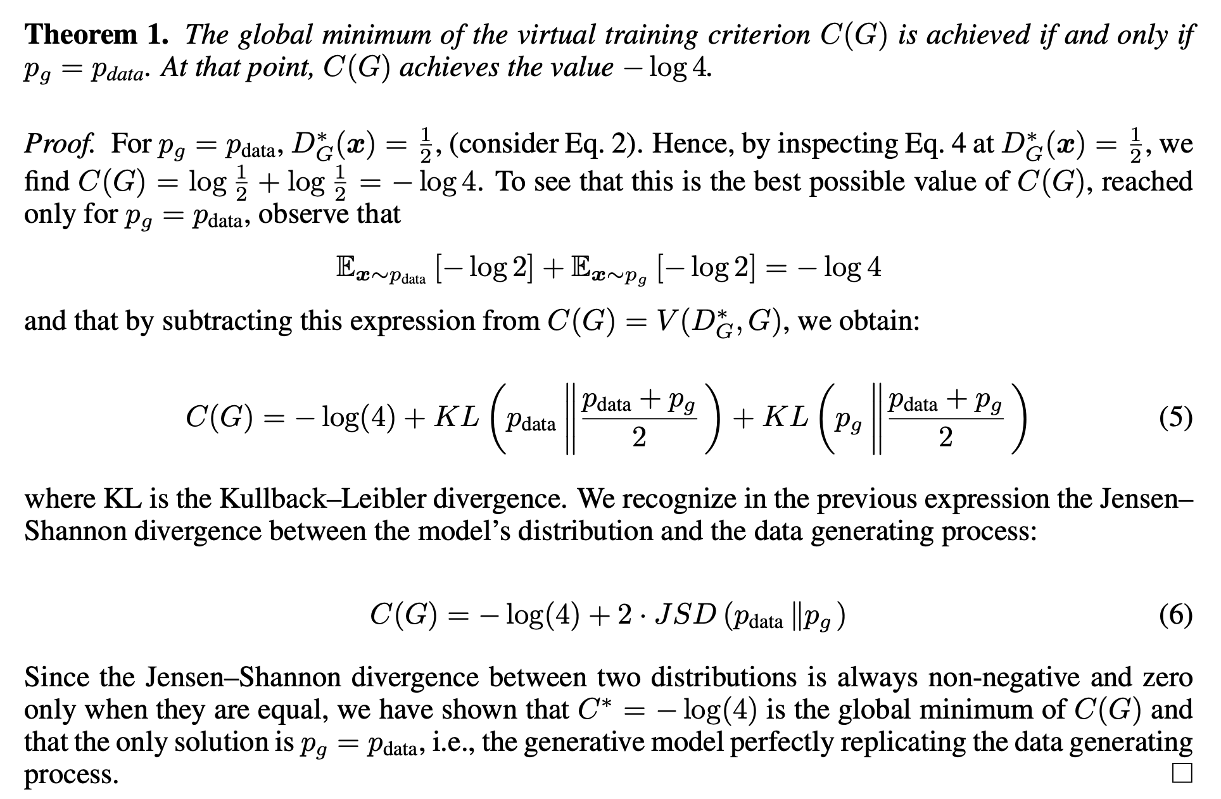

Slide 19
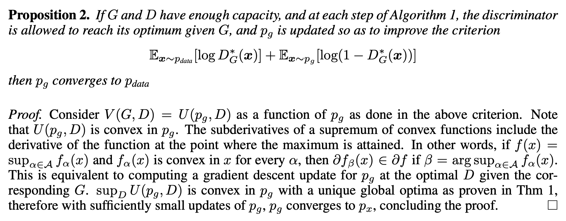
Convergence of the algorithm

Slide 20
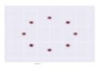
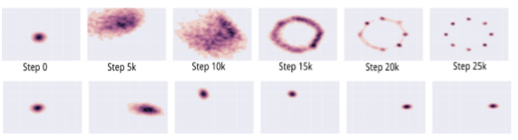
Mode-Collapse
Generator fails to output diverse samples
Target
Expected
Output

Slide 21
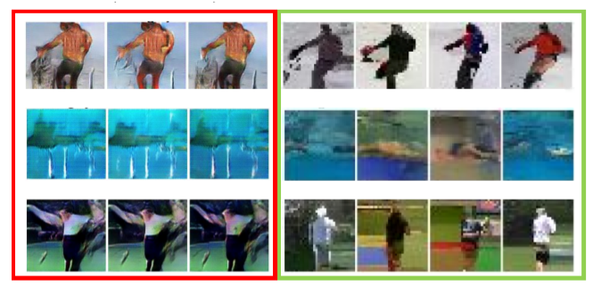
Some real examples

Slide 22
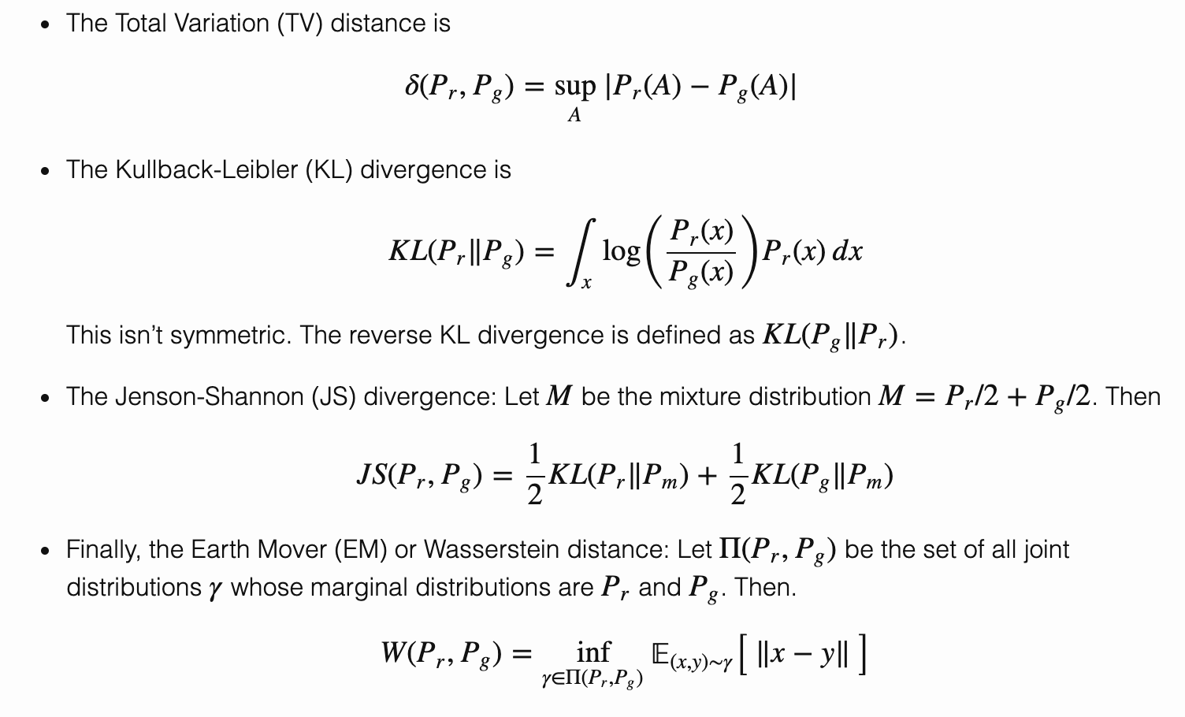
Distances between two distributions

Slide 23
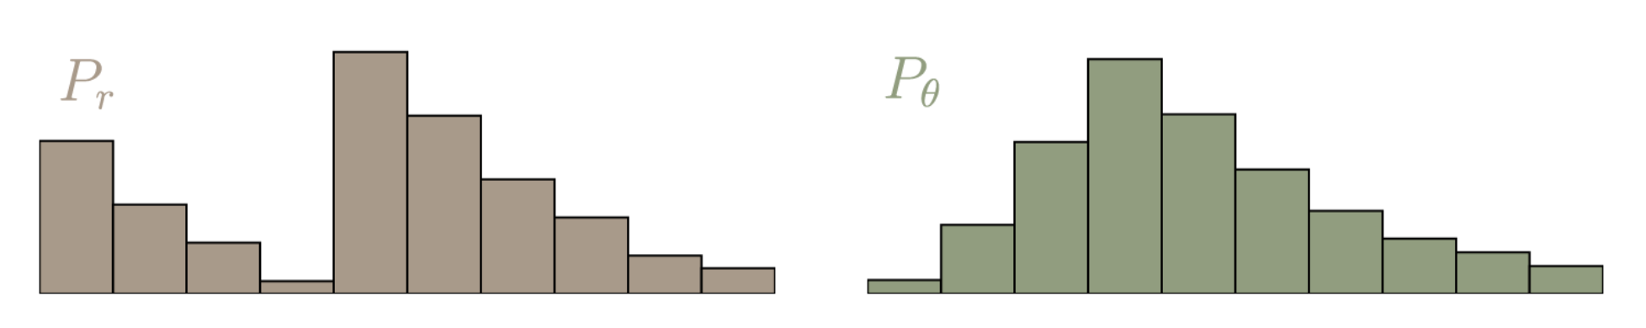
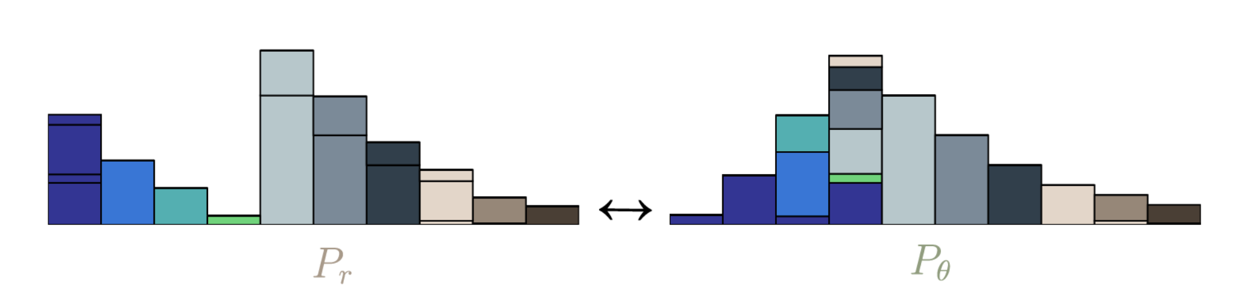
What is EMD? What is optimal transportation?

Slide 24
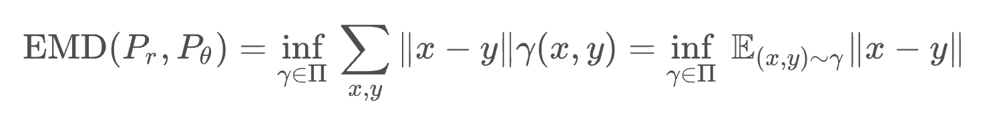
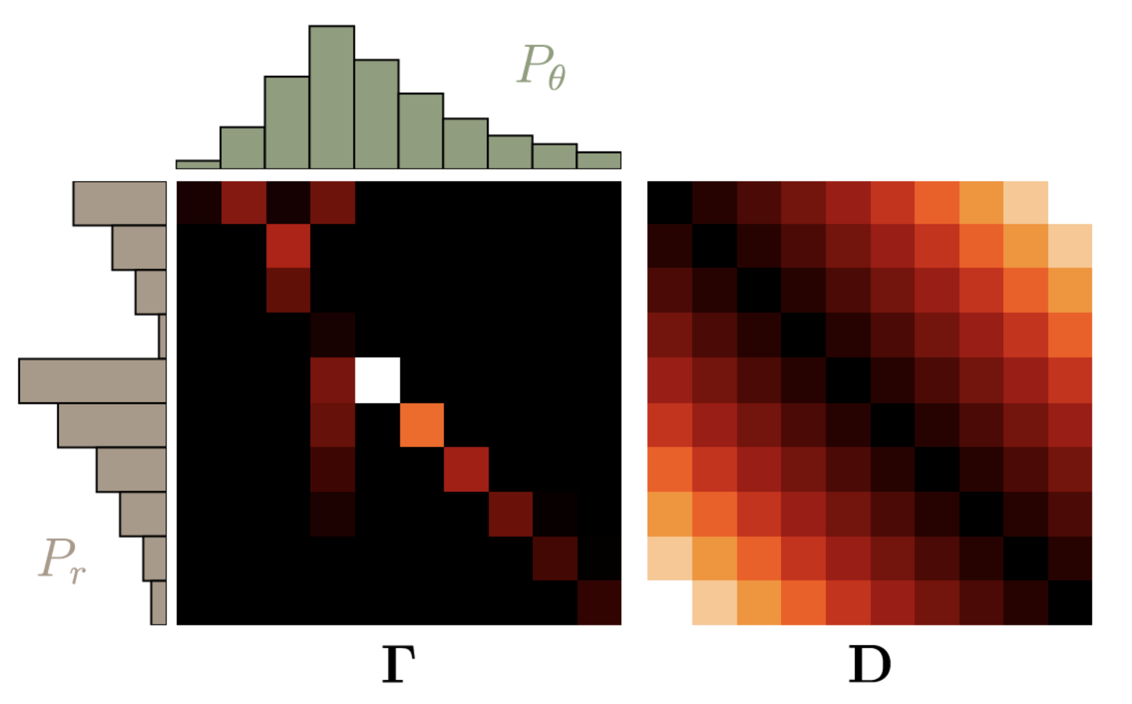
EMD and optimal transportation

Slide 25
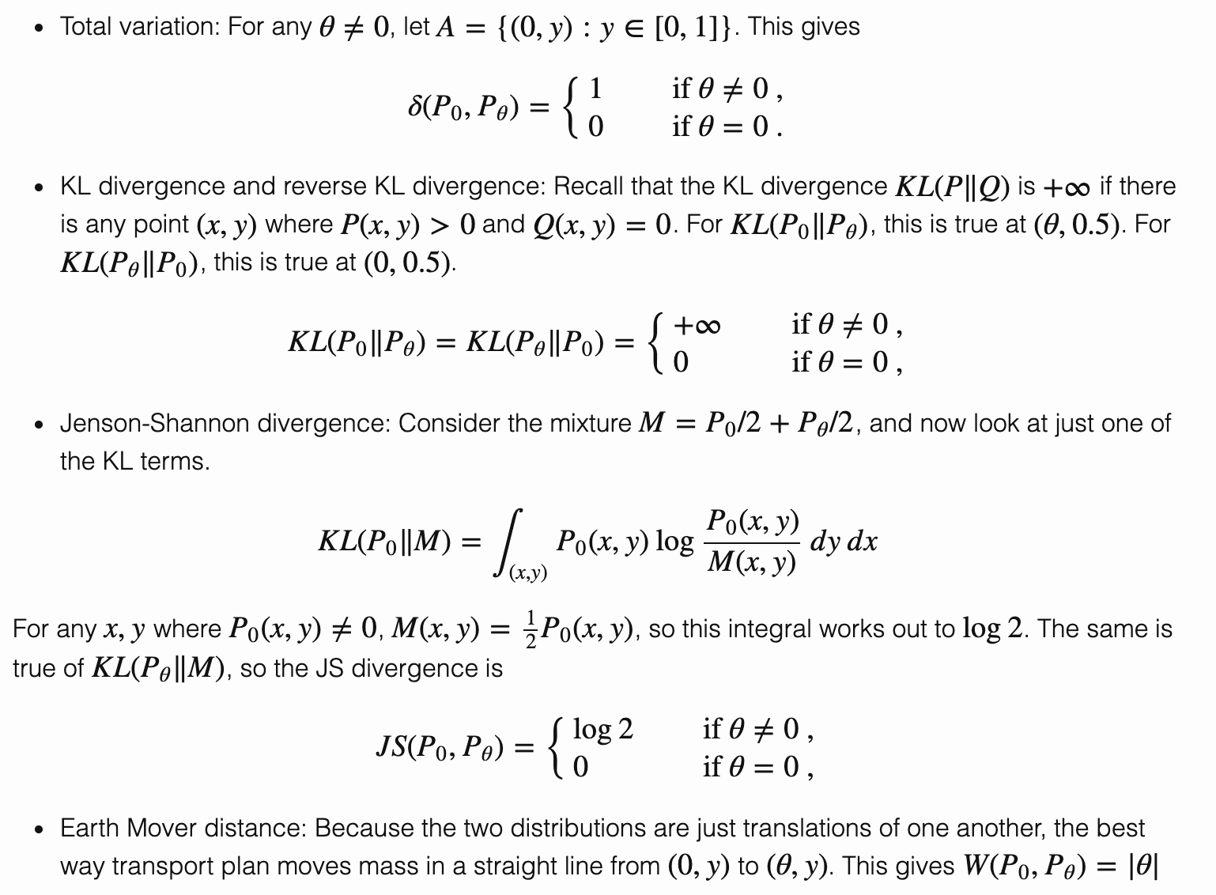
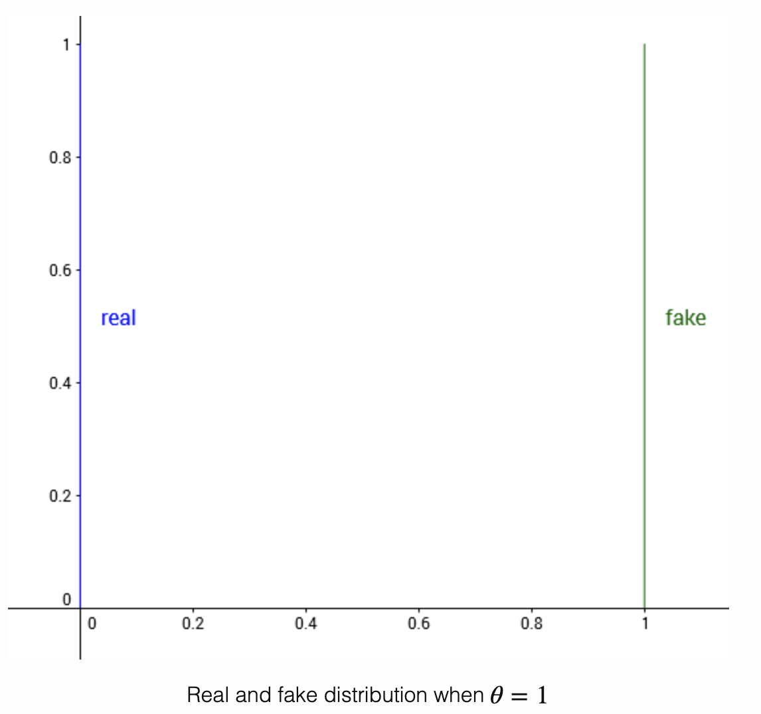
Why EMD?

Slide 26
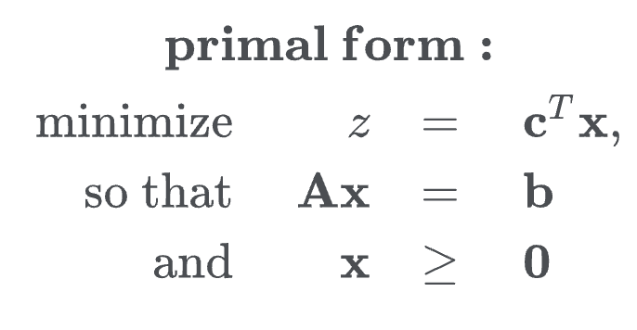
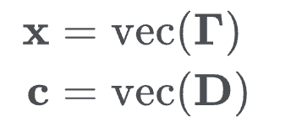
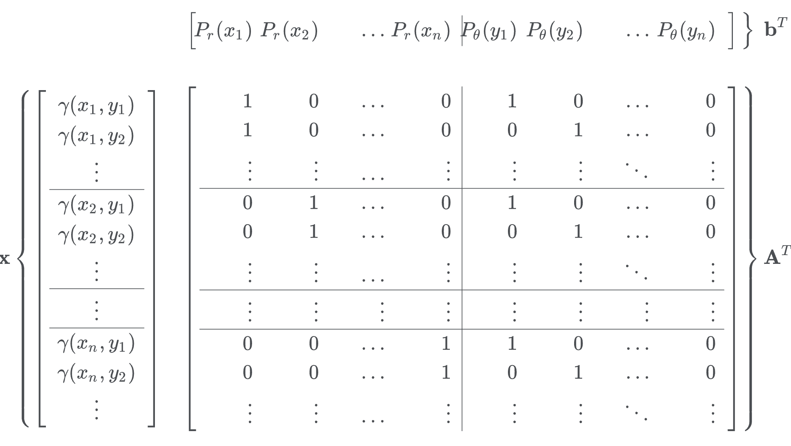
Linear programming

Slide 27
Difficulty of the primal form: dimensionality
In our example, we use a one-dimensional random variable with ten possible states.
The number of possible discrete states scales exponentially with the number of dimensions of the input variable. For many applications, e.g. images, the input can easily have thousands of dimensions.

Slide 28
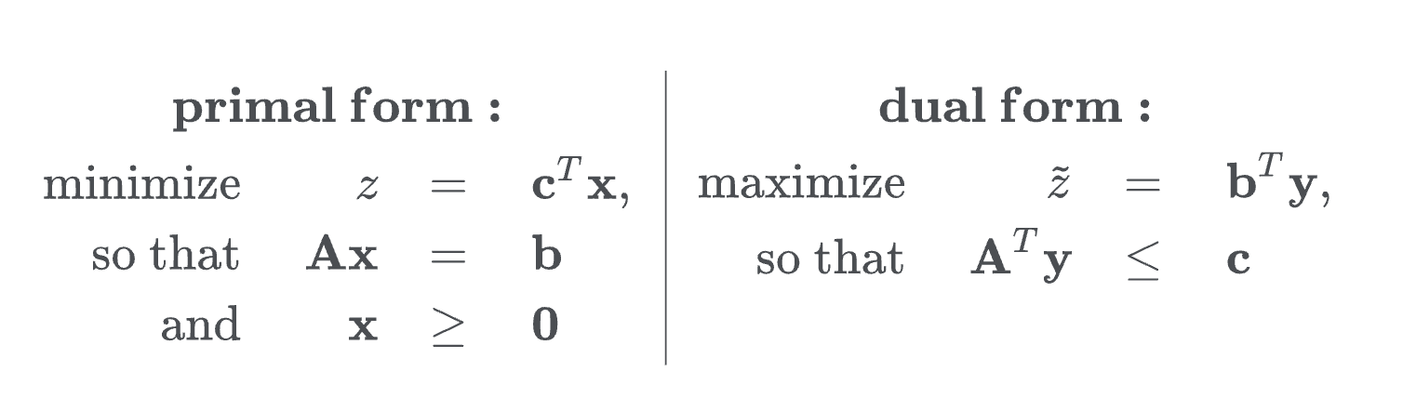
Use dual form instead
We do not care the optimal x, but only z, the EMD

Slide 29
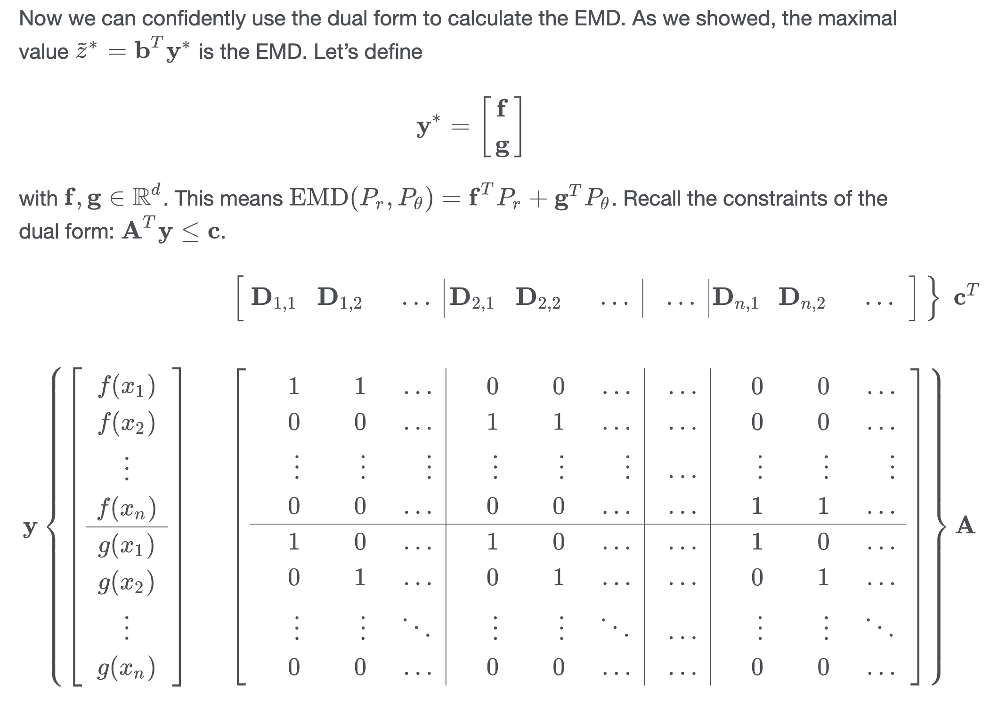
Dual form

Slide 30
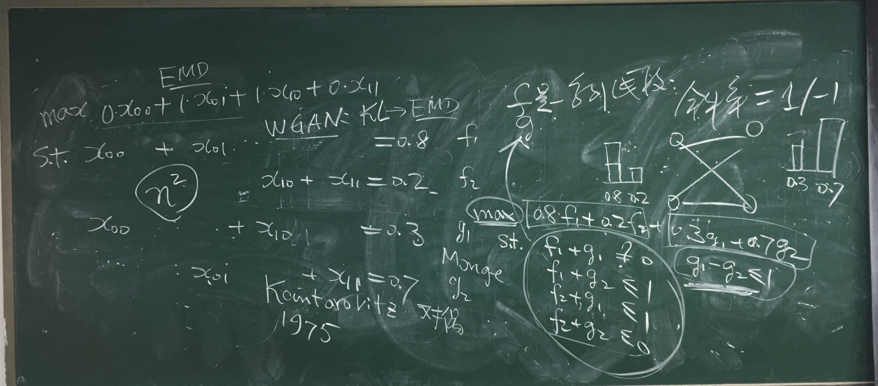
An example

Slide 31
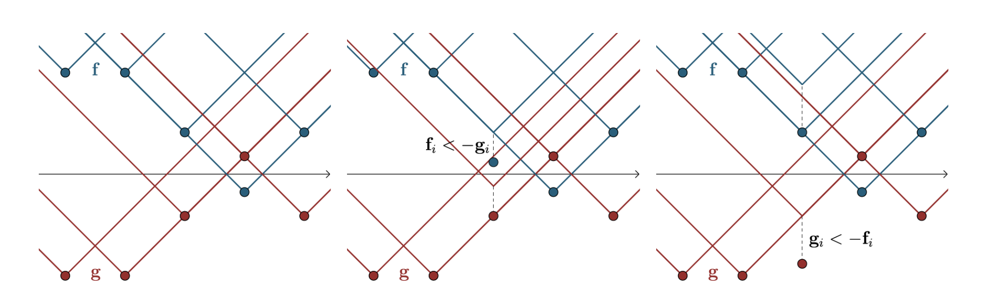
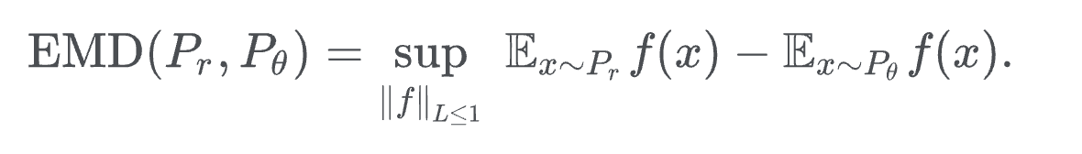
Why Lipschitz? f and g are linear segments
Lipschitz: the gradient is less than k

Slide 32
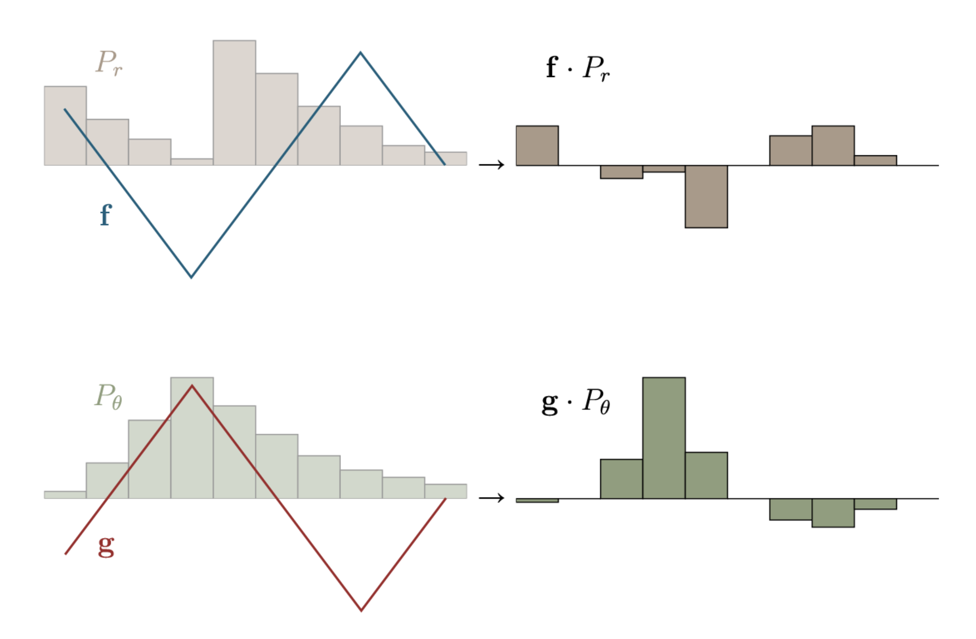
Optimal solution of the dual LP

Slide 33
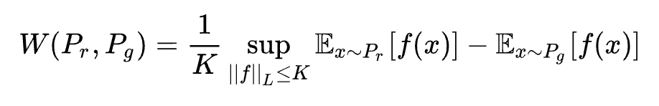
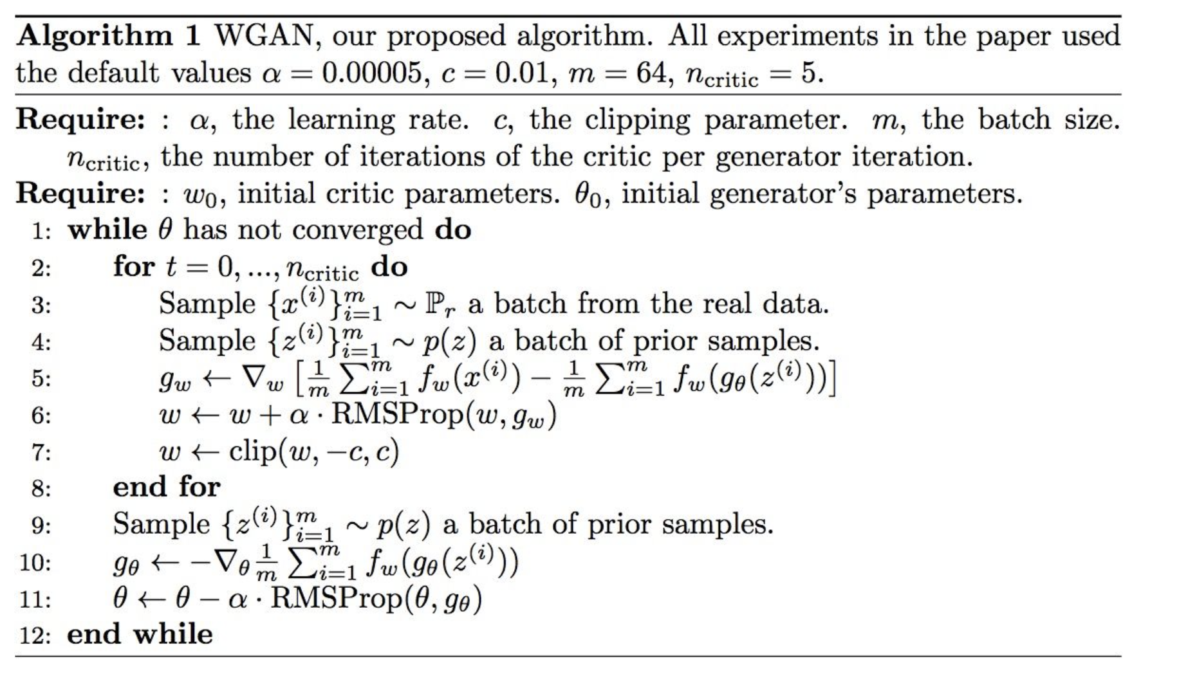
How to solve the dual LP? NN (without sigmoid)

